Slide 1

Basics of AI and ML
Dr. Venkataramana Veeramsetty
Center for AI and Deep Learning
SR University, Warangal

Slide 2
What is AI
Artificial intelligence is an intelligence that was developed in the form some mathematical operations and implemented using computer programming in order to make machines behaves like human intelligence to perform some task like
Decision making
Language translation
Visual perceptions
Speech recognition etc.

Slide 3
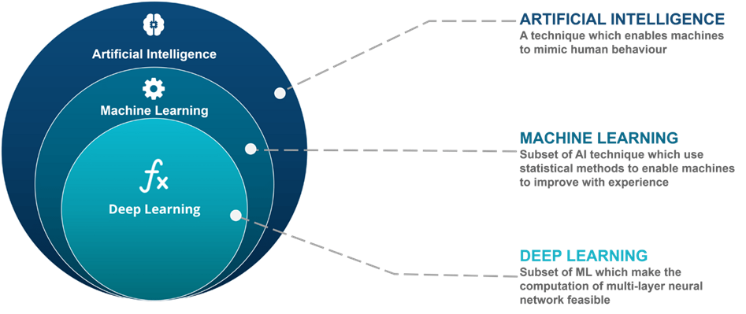
What is AI?
Artificial intelligence leverages computers and machines to mimic the problem-solving and decision-making capabilities of the human mind.

Slide 4
Need of AI
AI enables us to build amazing software that can improve health care, enable people to overcome physical disadvantages, empower smart infrastructure, create incredible entertainment experiences, and even save the planet!
https://www.microsoft.com/en-us/videoplayer/embed/RE4vyDl?postJsllMsg=true

Slide 5
Key Elements of AI
Machine learning - This is often the foundation for an AI system, and is the way we "teach" a computer model to make prediction and draw conclusions from data.
Anomaly detection - The capability to automatically detect errors or unusual activity in a system.
Computer vision - The capability of software to interpret the world visually through cameras, video, and images.
Natural language processing - The capability for a computer to interpret written or spoken language, and respond in kind.
Conversational AI - The capability of a software "agent" to participate in a conversation.

Slide 6
Understand machine learning
Machine Learning is the foundation for most AI solutions.
Sustainable farming techniques are essential to maximize food production while protecting a fragile environment. The Yield, an agricultural technology company based in Australia, uses sensors, data and machine learning to help farmers make informed decisions related to weather, soil and plant conditions.
https://www.microsoft.com/en-us/videoplayer/embed/RE4voJG?postJsllMsg=true

Slide 7
How machine learning works
https://docs.microsoft.com/en-us/learn/wwl-data-ai/get-started-ai-fundamentals/media/machine-learn.gif

Slide 8
Understand anomaly detection
Imagine you're creating a software system to monitor credit card transactions and detect unusual usage patterns that might indicate fraud.
An application that tracks activity in an automated production line and identifies failures.
A racing car telemetry system that uses sensors to proactively warn engineers about potential mechanical failures before they happen.
https://docs.microsoft.com/en-us/learn/wwl-data-ai/get-started-ai-fundamentals/media/anomaly-detection.gif

Slide 9
Understand computer vision
Computer Vision is an area of AI that deals with visual processing. Seeing AI
Image classification
Object detection
Semantic segmentation
Image analysis
Face detection, analysis, and recognition
Optical character recognition (OCR)

Slide 10
Computer vision services in Microsoft Azure
Computer Vision--You can use this service to analyze images and video, and extract descriptions, tags, objects, and text.
Custom Vision--Use this service to train custom image classification and object detection models using your own images.
Face--The Face service enables you to build face detection and facial recognition solutions.
Form Recognizer-- Use this service to extract information from scanned forms and invoices.
https://aidemos.microsoft.com/computer-vision

Slide 11
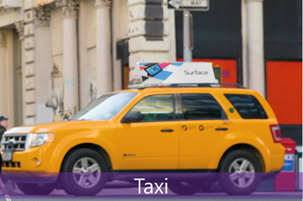
Image classification
Image classification involves training a machine learning model to classify images based on their contents. For example, in a traffic monitoring solution you might use an image classification model to classify images based on the type of vehicle they contain, such as taxis, buses, cyclists, and so on.

Slide 12

CoinNet: A Mobile App
Center for AI and Deep Learning, Developed an AI based Mobile Application to identify Indian Currency
This app can be helpful for the visually impaired people to recognize currency notes

Slide 13
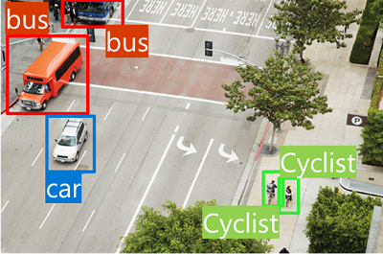
Object detection
Object detection machine learning models are trained to classify individual objects within an image and identify their location with a bounding box. For example, a traffic monitoring solution might use object detection to identify the location of different classes of vehicle.

Slide 14
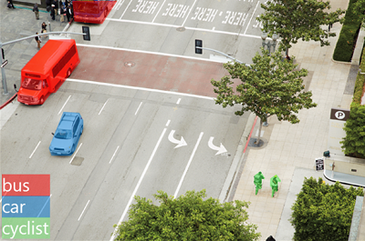
Semantic segmentation
Semantic segmentation is an advanced machine learning technique in which individual pixels in the image are classified according to the object to which they belong. For example, a traffic monitoring solution might overlay traffic images with "mask" layers to highlight different vehicles using specific colors.

Slide 15
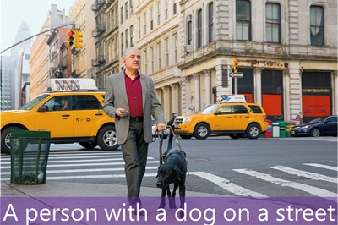
Image analysis
You can create solutions that combine machine learning models with advanced image analysis techniques to extract information from images, including "tags" that could help catalog the image or even descriptive captions that summarize the scene shown in the image.

Slide 16
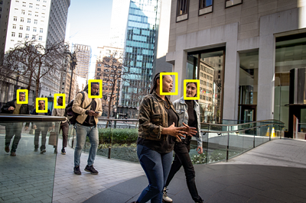
Face detection, analysis, and recognition
Face detection is a specialized form of object detection that locates human faces in an image. This can be combined with classification and facial geometry analysis techniques to infer details such as age and emotional state; and even recognize individuals based on their facial features.

Slide 17

Optical character recognition (OCR)
Optical character recognition is a technique used to detect and read text in images.

Slide 18
Natural language processing
Natural language processing (NLP) is the area of AI that deals with creating software that understands written and spoken language
Analyze and interpret text in documents, email messages, and other sources.
Interpret spoken language and synthesize speech responses.
Automatically translate spoken or written phrases between languages
Interpret commands and determine appropriate actions.

Slide 19
Example
Starship Commander, is a virtual reality (VR) game from Human Interact, that takes place in a science fiction world. The game uses natural language processing to enable players to control the narrative and interact with in-game characters and starship systems.
https://www.microsoft.com/en-us/videoplayer/embed/RE4vyDj?postJsllMsg=true

Slide 20
Conversational AI
Conversational AI is the term used to describe solutions where AI agents participate in conversations with humans
Conversational AI solutions use bots to manage dialogs with users.
These dialogs can take place through web site interfaces, email, social media platforms, messaging systems, phone calls, and other channels.

Slide 21
Conversational AI
Conversational AI is the term used to describe solutions where AI agents participate in conversations with humans
Conversational AI solutions use bots to manage dialogs with users.
These dialogs can take place through web site interfaces, email, social media platforms, messaging systems, phone calls, and other channels.

Slide 22
You want to create a model to predict sales of ice cream based on historic data that includes daily ice cream sales totals and weather measurements. Which Azure service should you use?
Azure Machine Learning
QnA Maker
Text Analytics

Slide 23
You want to train a model that classifies images of dogs and cats based on a collection of your own digital photographs. Which Azure service should you use?
Computer Vision
Custom Vision Azure Bot Service

Slide 24


Slide 25
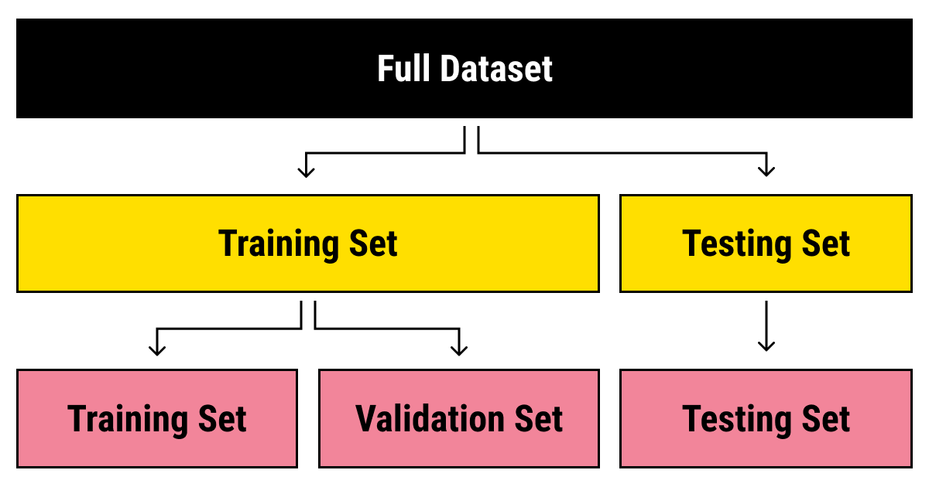
Data Split

Slide 26
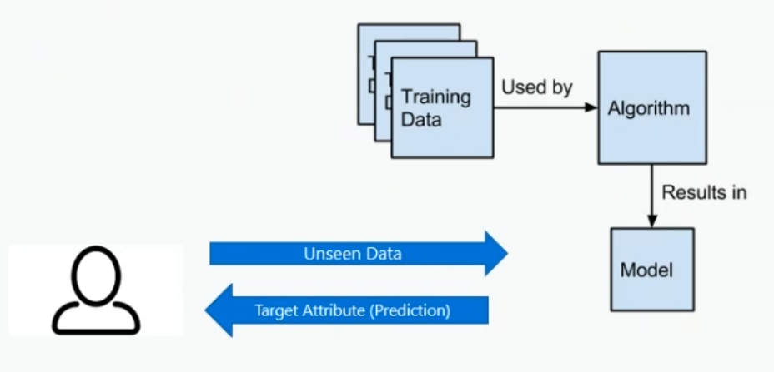
What is a Model

Slide 27
Principals of Responsible AI
Fairness
Reliability & Safety
Privacy & Security
Inclusiveness
Transparency
Accountability
Responsible AI

Slide 28
Learning Algorithms
Supervised Learning
Unsupervised Learning (Clustering & Association)
Semi Supervised Learning (Label and Unlabel)

Slide 29
Real time problems
Regression
Classification
Clustering

Slide 30
Regression
Simple Linear Regression
Multiple Linear Regression
Polynomial Regression

Slide 31
Advantages & Limitations of Regression
Continues value prediction
Simple to understand and implement
Simple mathematics
Much lower training time as it is simple model
Cannot perform well on complex real time problems

Slide 32
Applications
Load demand prediction
Stock price prediction
Credit score assessment

Slide 33
Binary Classification Problems
Patient affected with covid or not?
Can issue credit card or not?

Slide 34
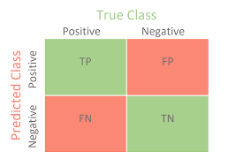
Confusion Matrix

Slide 35
Categorical Classification Problem
Type of faults (Ex, LG, LL, LLG, LLLG)
Mood of tweet (Ex. Happy, Sad, Angry)

Slide 36

ML Studio Classic

Slide 37
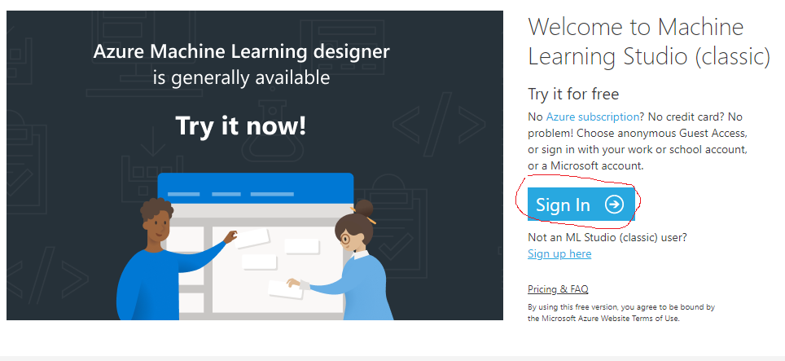
ML studio Classic
Login to portal ML studio classic : https://studio.azureml.net/

Slide 38
Missing Value Information for each Column
Symboling: 06
normalized-losses: 41
num-of-doors, horsepower, peak-rpm, :2
Bore, stroke, Price:4
wheel-basefuel-type, Make,body-style, Aspiration, Curb weight,engine-type,num-of-cylinders, engine-location, drive-wheel, length, width,hight, fuel type, engine-size, fuel system, compression-ratio, city-mpg, highway-mpg, :0

Slide 39
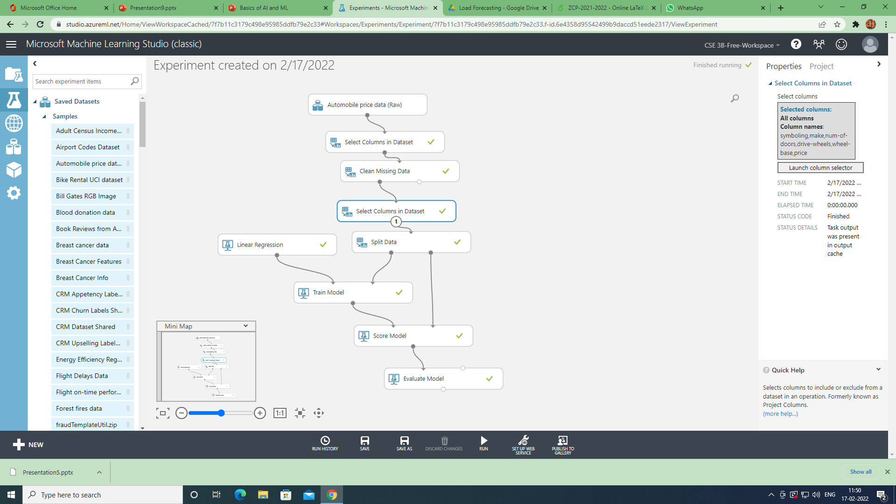

Slide 40
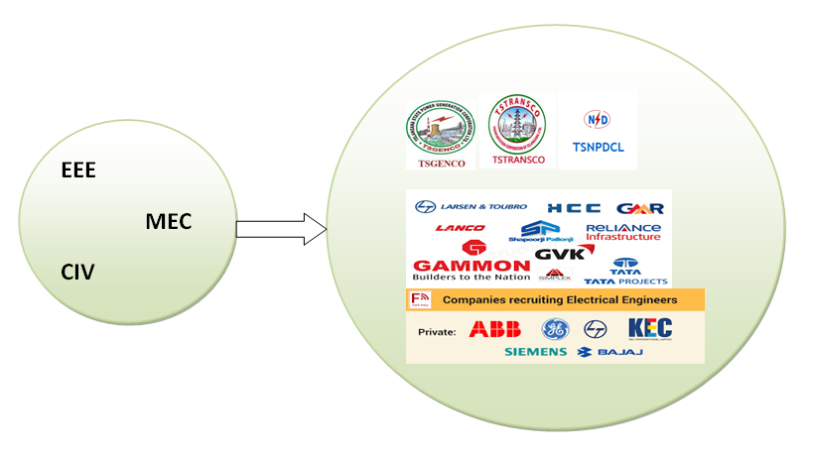
Opportunities Space

Slide 41
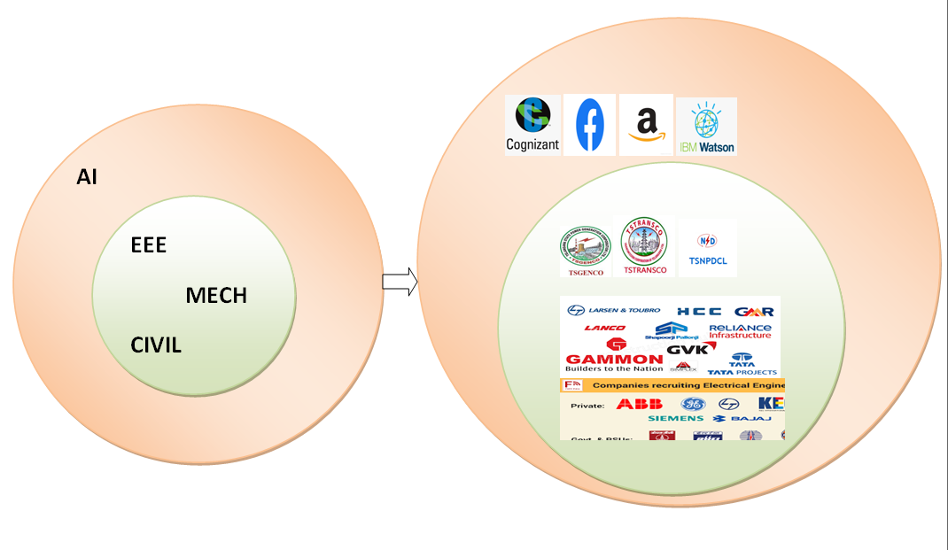
Opportunities Space

Slide 42
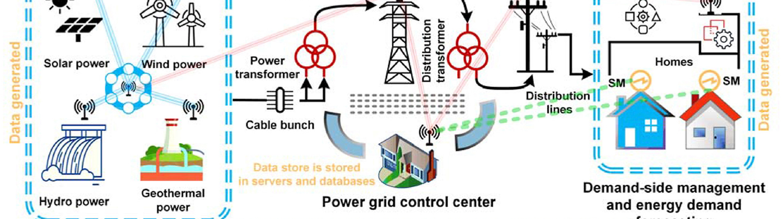
Domain Applications : Electrical Engineering
Wind and Solar Energy Forecasting
Load frequency control
Load and market price forecasting
Speed control
Faults Identification

Slide 43
Domain Applications : Civil Engineering
Innovative concrete mix proportion
Strength prediction of concrete
Structural analysis of members by special concrete
Water quality assurance
Special concrete mix design and strength prediction

Slide 44

THANK YOU

